Slide 1
SonarQube
The powerful Code Analyzer

Slide 2
What is SonarQube?
It’s a Code Analyzer tool and open source software
It supports various languages like Java, C#, PHP, etc..
It can be integrated with Eclipse with SonarLite plugin, So that at the time of development all Code review issues can be resolved. At the time Unit testing, UT issues count will be less.
It can be integrated with build tools like ANT, MAVEN, GRADLE

Slide 3
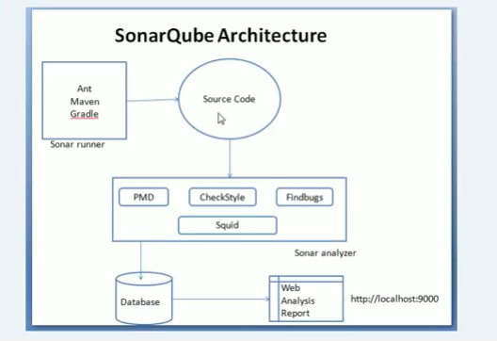
SonarQube Architecture

Slide 4
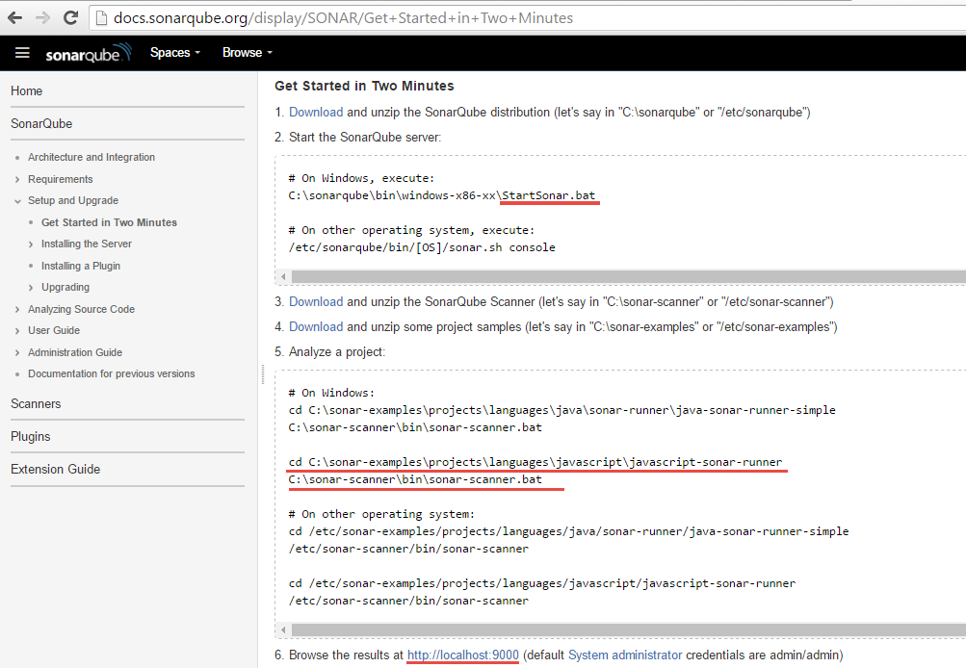

Slide 5
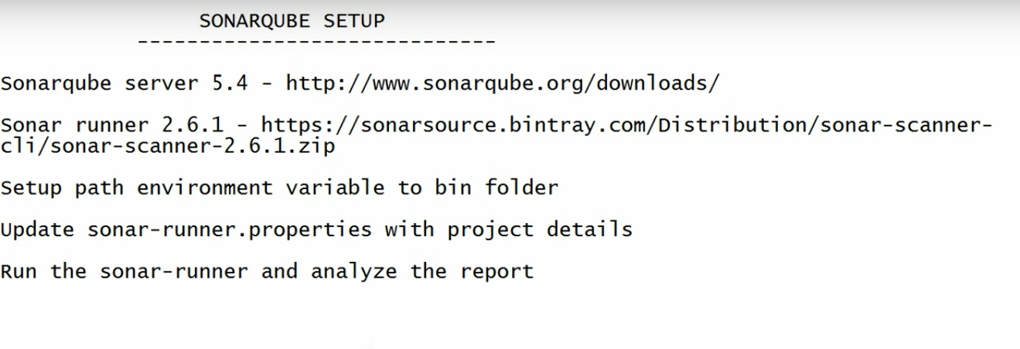
Sonarqube installation

Slide 6
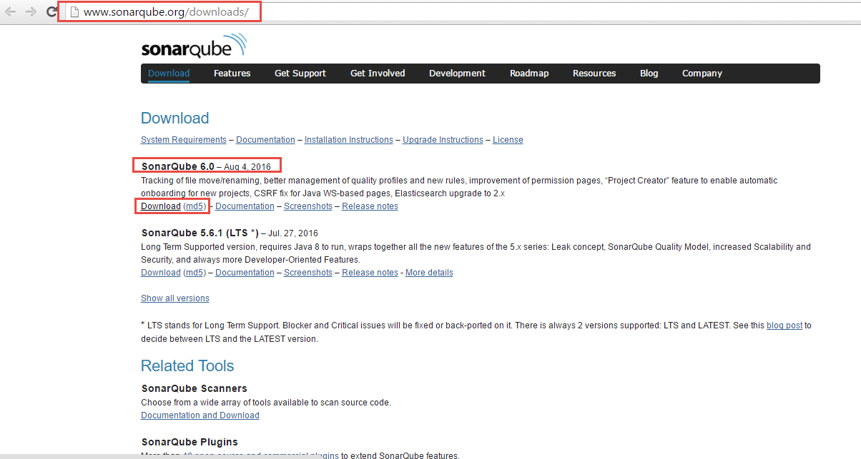
Download sonar server

Slide 7
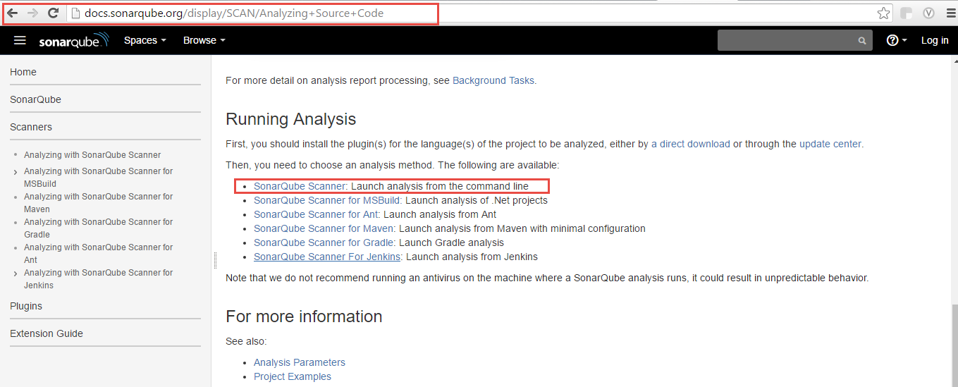
Download sonar runner (scanner) – it can be integrated with jetkins, maven or gradle

Slide 8
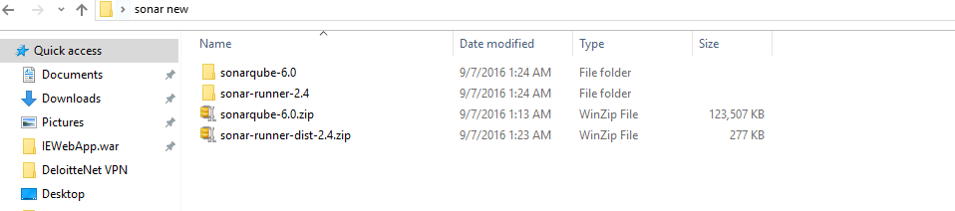
Extract the downloaded files

Slide 9
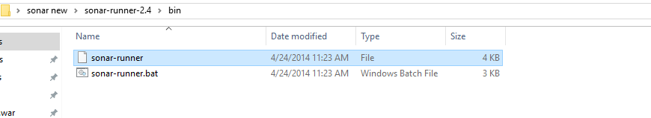
Sonar-runner or sonar-scanner exe file location to add to path

Slide 10
Note
Sonar runner and sonar scanner both are same.
Sonar runner is renamed to sonar scanner from latest version onwards

Slide 11
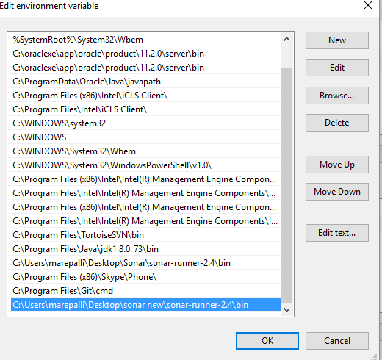
Add sonar scanner entry to the path up to bin from SonarScanner folder

Slide 12
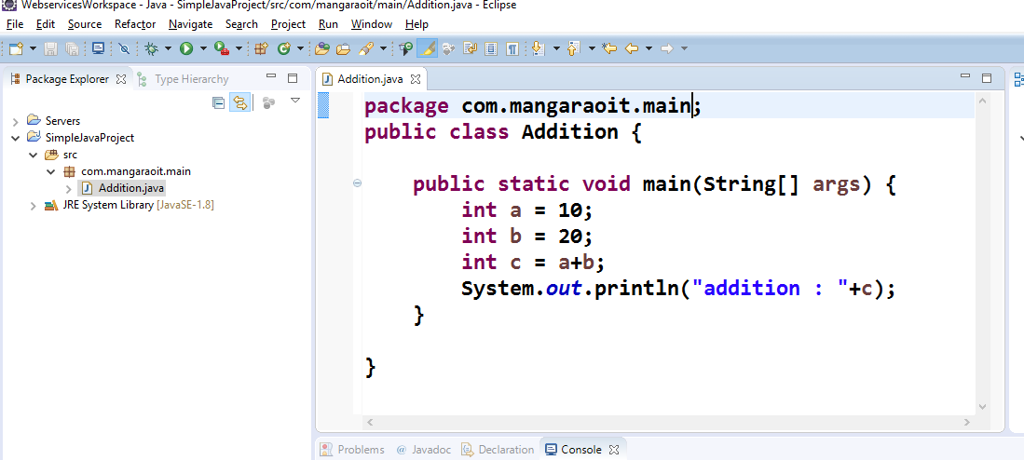
Analyse Sonarqube report – To analyze source code, first create a java project in eclipse - SimpleJavaProject

Slide 13
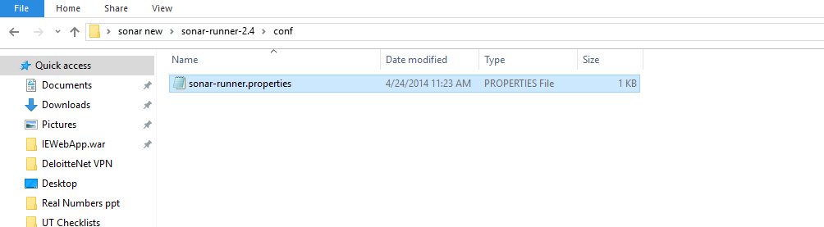
Open sonar-runner.properties file

Slide 14
Changes in sonar
Port no can be changed. Database details can be changed or Use default database. Add new project details. (Add project path created in eclipse)
sonar.projectKey=SimpleJavaProject
sonar.projectName=SimpleJavaProject
sonar.projectVersion=1.0
sonar.sources=src\\com\\mangaraoit\\main

Slide 15
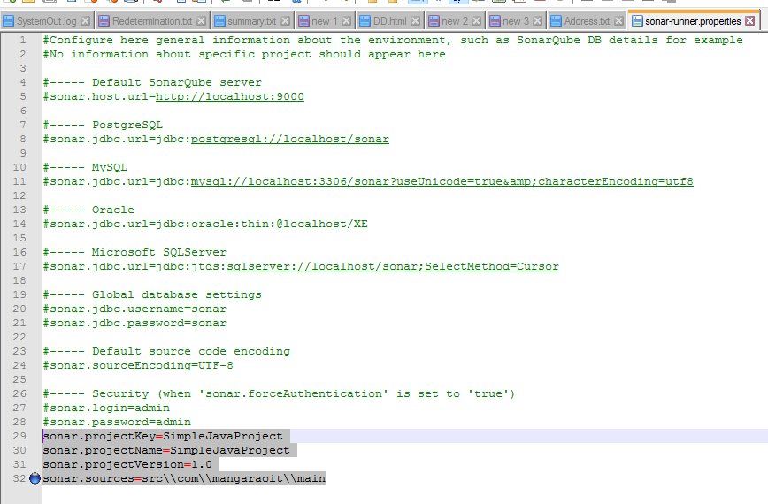

Slide 16
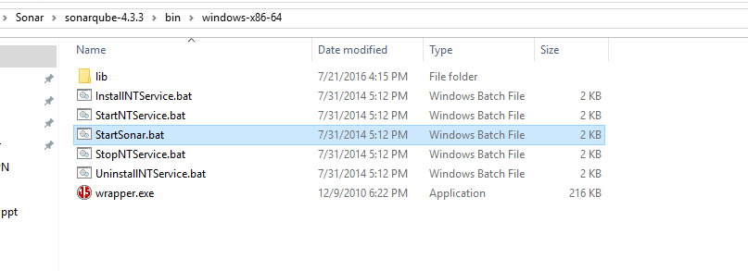
Start sonar runner
Go to the below specific OS location and click on StartSonar.bat file or run the file from command prompt
#----- Default SonarQube server
#sonar.host.url=http://localhost:9000

Slide 17
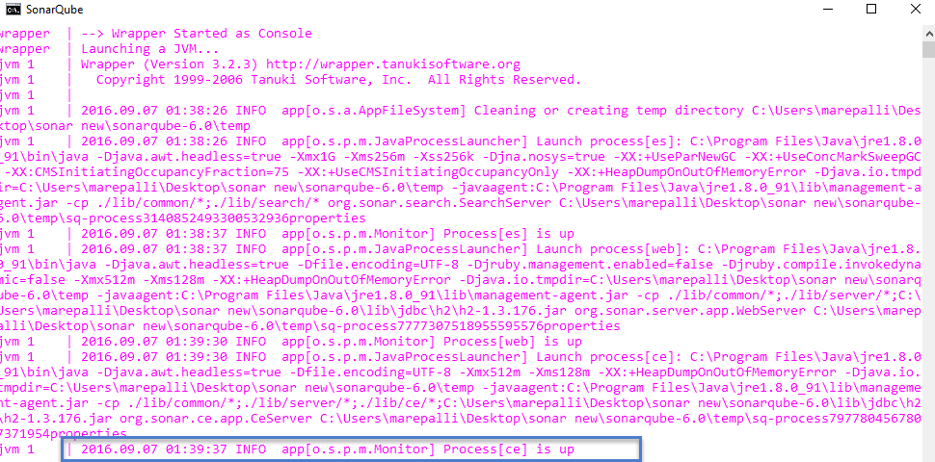
Once sonar server is up, run sonar report

Slide 18
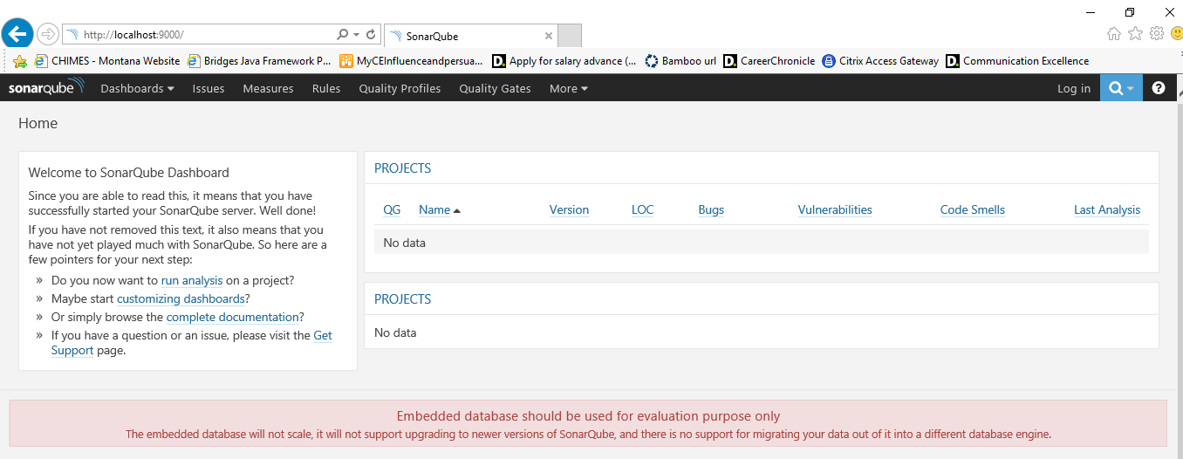
Execute http://localhost:9000 – No projects analyzed

Slide 19
Run sonar-runner command
Go to the project base directory location and execute sonar-runner
We can run the sonar-runner.bat or sonar-runner.exe file.
Cd C:\\Users\\marepalli\\Desktop\\WebservicesWorkspace\\SimpleJavaProject
C:\...SimpleJavaProject> sonar-runner.bat

Slide 20
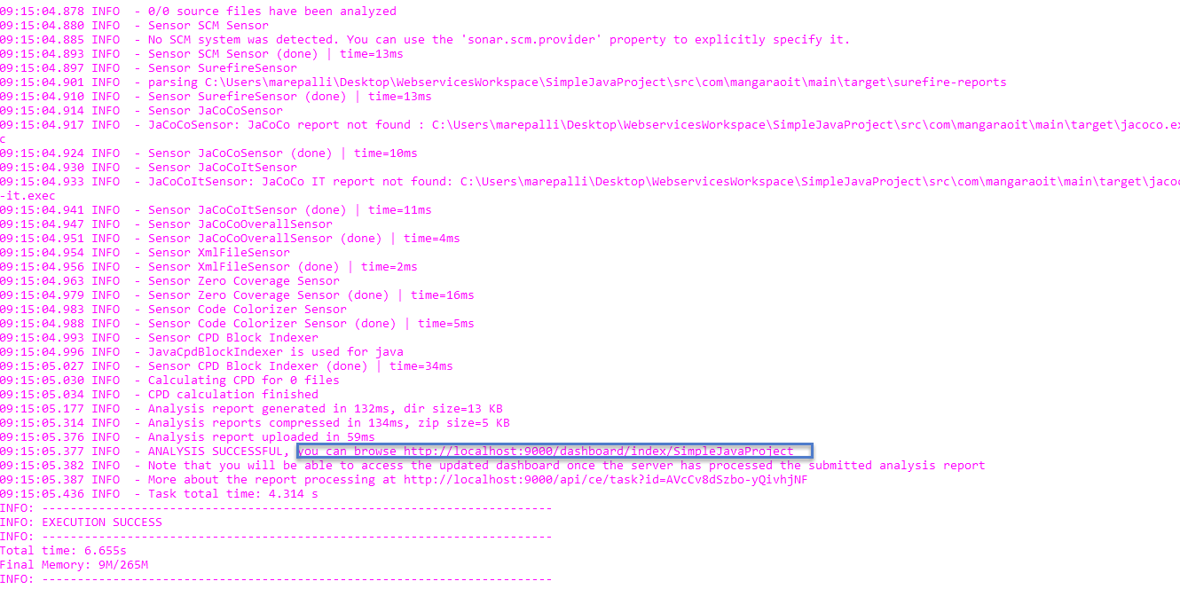

Slide 21
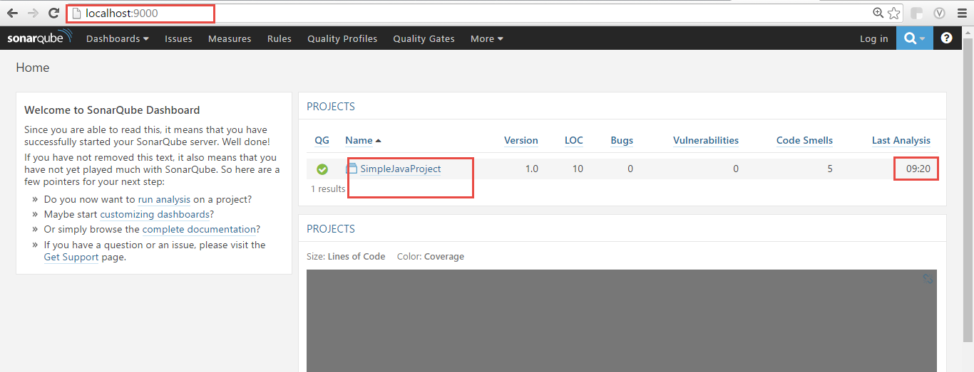
Hit http://localhost:9000

Slide 22
Sonar lint plugin integration with Eclipse

Slide 23
Eclipse Sonarlint plugin integration steps
1. Go to Eclipse market place
2. search with ‘Sonarlint’ keyword
3. Select Sonarlint results, click on Install
4. Accept the license, click on Next, Finish
5. Restart the eclipse
6. Right click on project – SonarLint – Bind to Sonar Qube project
7. Go to show view and select SonarLintIssues and SonarLintRuleDescription

Slide 24
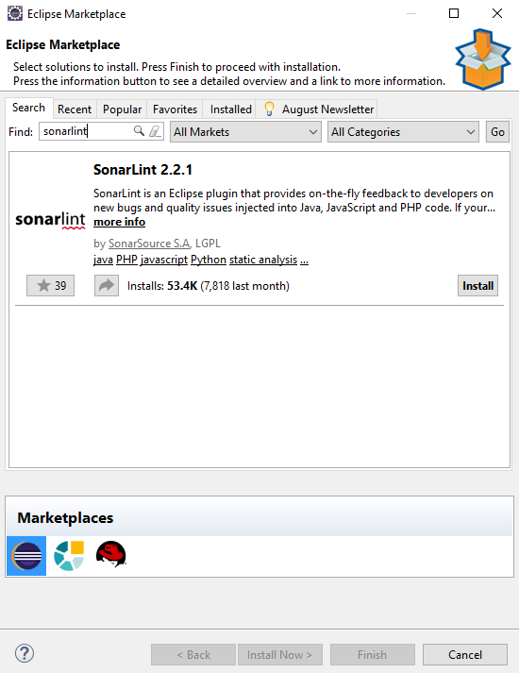

Slide 25
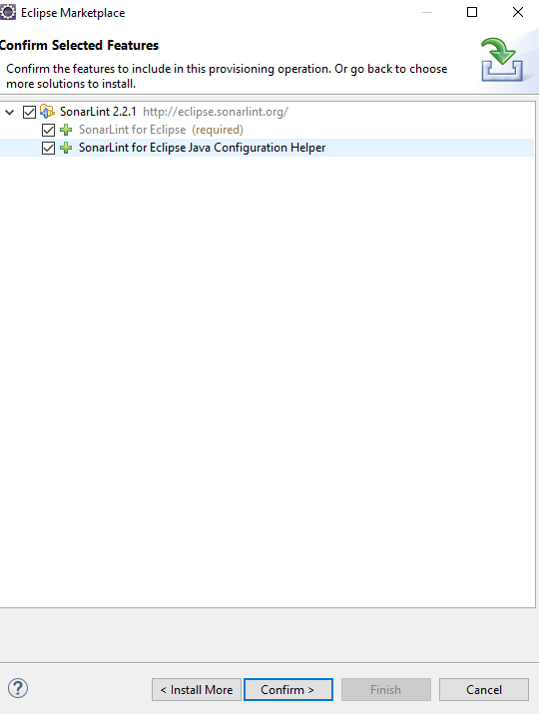

Slide 26
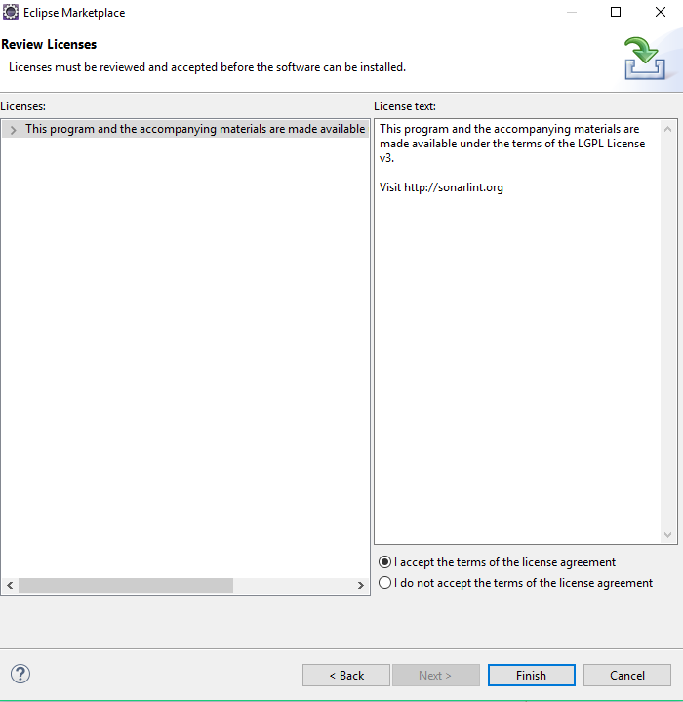

Slide 27
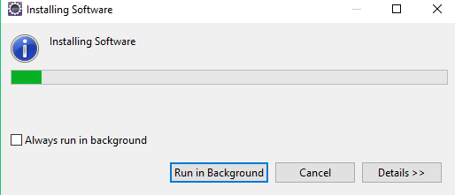

Slide 28
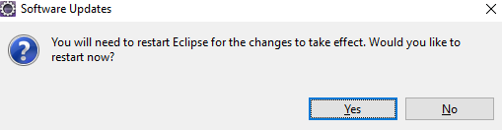

Slide 29
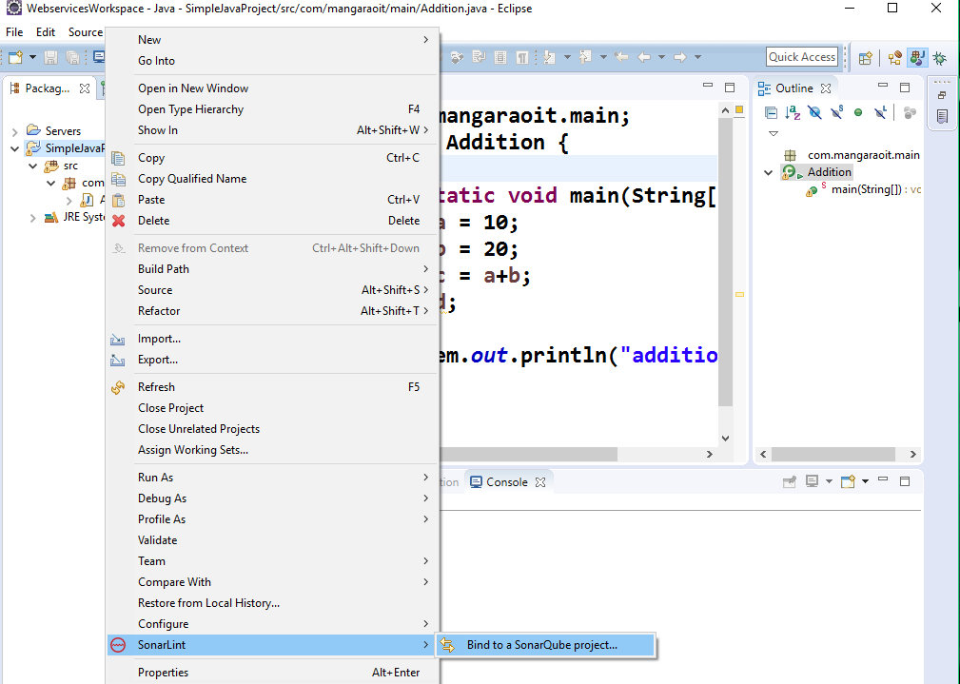

Slide 30
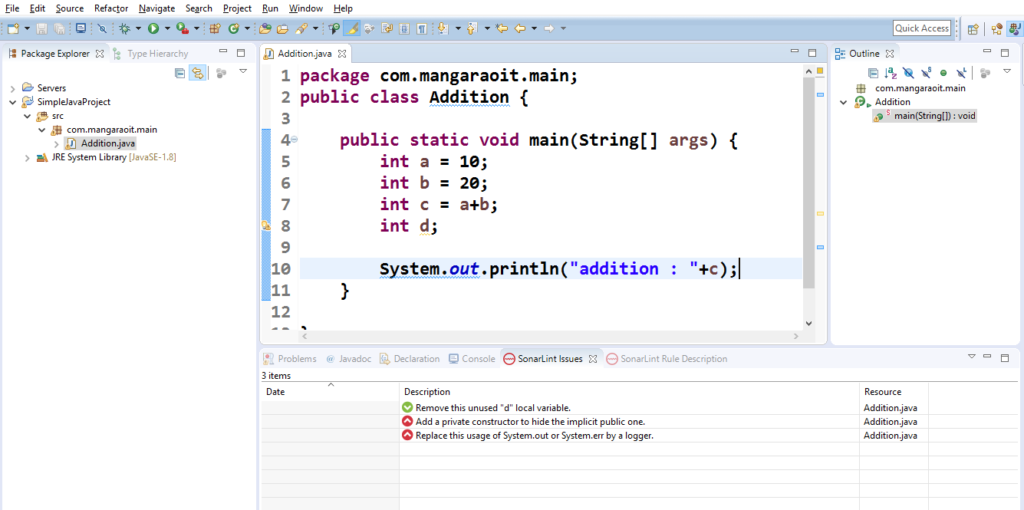
When source code is changed, if there are any issues, automatically those are displayed

